Slide 1
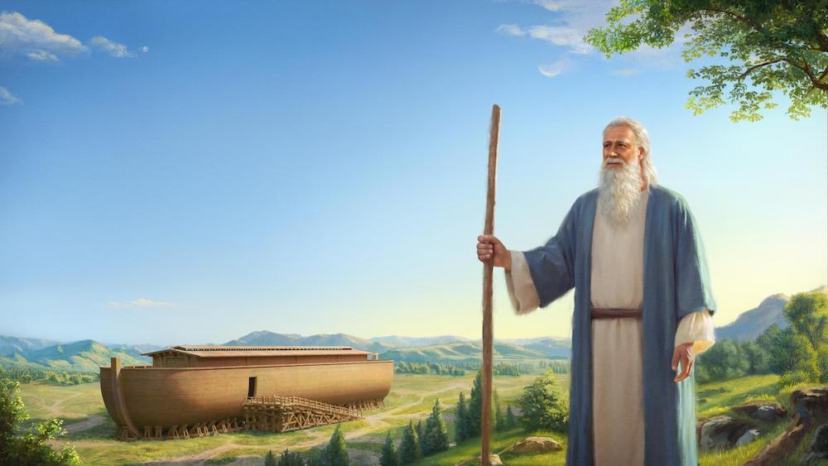
GENESIS LESSON 8
CHAPTERS –7
NOVEMBER 5, 2026
LARGO-SEMINOLE LADIES BIBLE STUDY
LSWBS.ORG

Slide 2
By faith Noah, being warned by God concerning events as yet unseen, in reverent fear constructed an ark for the saving of his household. By this he condemned the world and became an heir of the righteousness that comes by faith.
Hebrews 11:7 ESV

Slide 3
"This is like the days of Noah to me: as I swore that the waters of Noah should no more go over the earth, so I have sworn that I will not be angry
with you, and will not rebuke you.
Isaiah 54:9 ESV
even if these three men, Noah, Daniel, and Job, were in it, they would deliver but their own lives by their righteousness, declares the Lord GOD. Ezekiel 14:14 ESV

Slide 4
because they formerly did not obey, when God's patience waited in the days of Noah, while the ark was being prepared, in which a few, that is, eight persons, were brought safely through water.
1 Peter 3:20 ESV
[God] did not spare the ancient world, but preserved Noah, a herald of righteousness, with seven others, when he brought a flood upon the world of the ungodly; 2 Peter 2:5 ESV

Slide 5
For as were the days of Noah, so will be the coming of the Son of Man. For as in those days before the flood they were eating and drinking, marrying and giving in marriage, until the day when Noah entered the ark, and they were unaware until the flood came and swept them all away, so will be the coming of the Son of Man.
Matthew 24:37-39 ESV

Slide 6
For by grace you have been saved through faith. And this is not your own doing; it is the gift of God, not a result of works…Ephesians 2:8=9 ESV
who saved us and called us to a holy calling, not because of our works but because of his own purpose and grace,
2 Timothy 1:9 ESV
he saved us, not because of works done by us in righteousness, but according to his own mercy,
Titus 3:5 ESV

Slide 7
For by grace you have been saved through faith. And this is not your own doing; it is the gift of God, not a result of works…Ephesians 2:8=9 ESV
who saved us and called us to a holy calling, not because of our works but because of his own purpose and grace,
2 Timothy 1:9 ESV
he saved us, not because of works done by us in righteousness, but according to his own mercy,
Titus 3:5 ESV

Slide 8
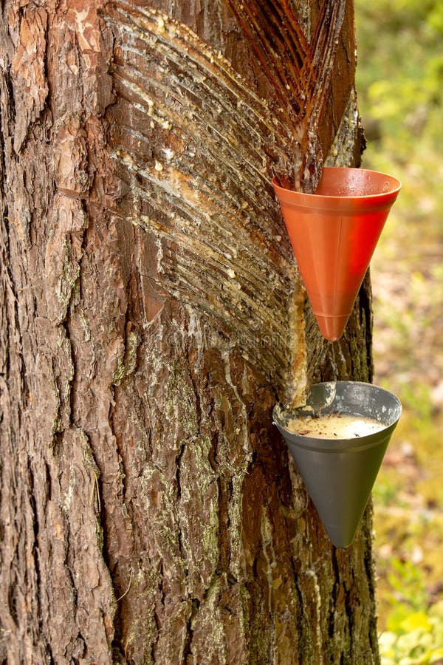
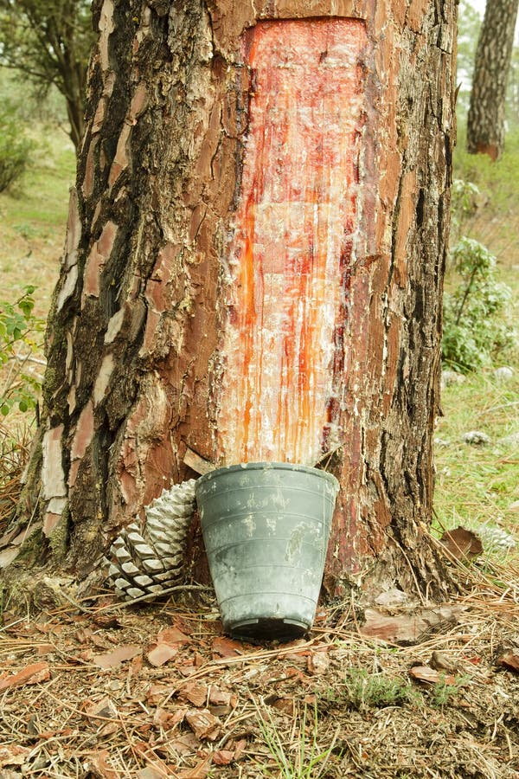

Slide 9
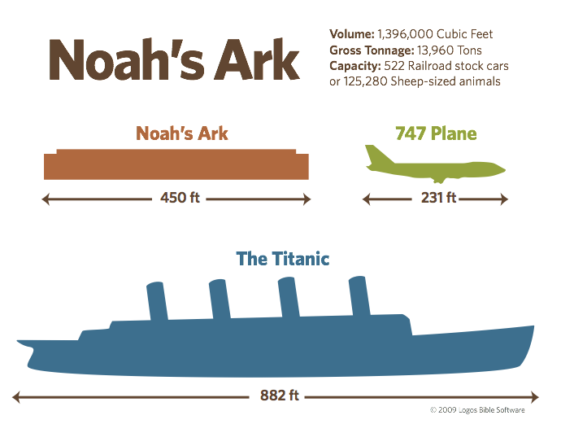

Slide 10
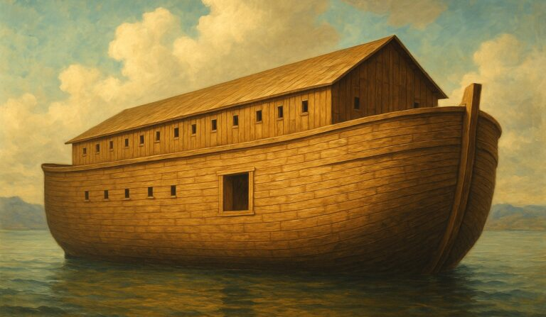

Slide 11
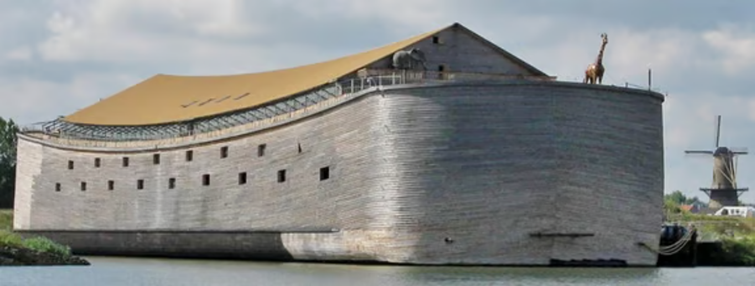

Slide 12
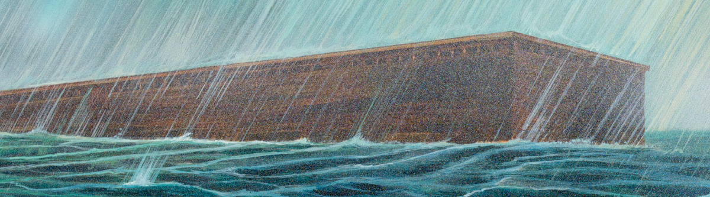

Slide 13
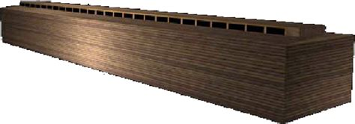

Slide 14
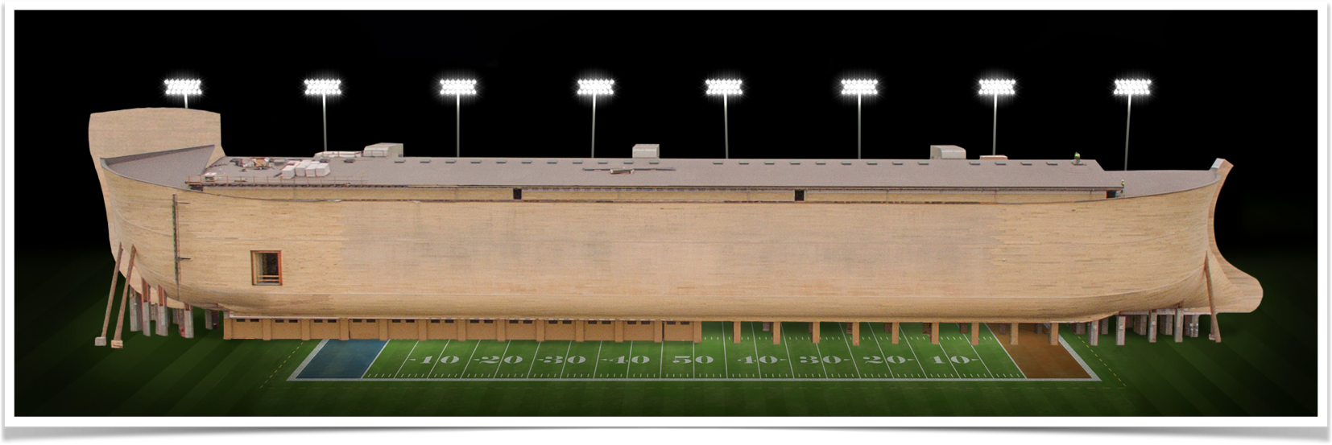

Slide 15
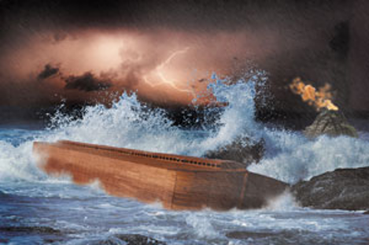

Slide 16
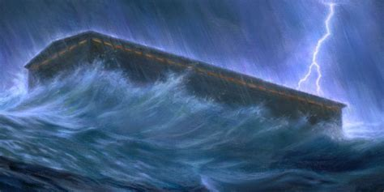

Slide 17
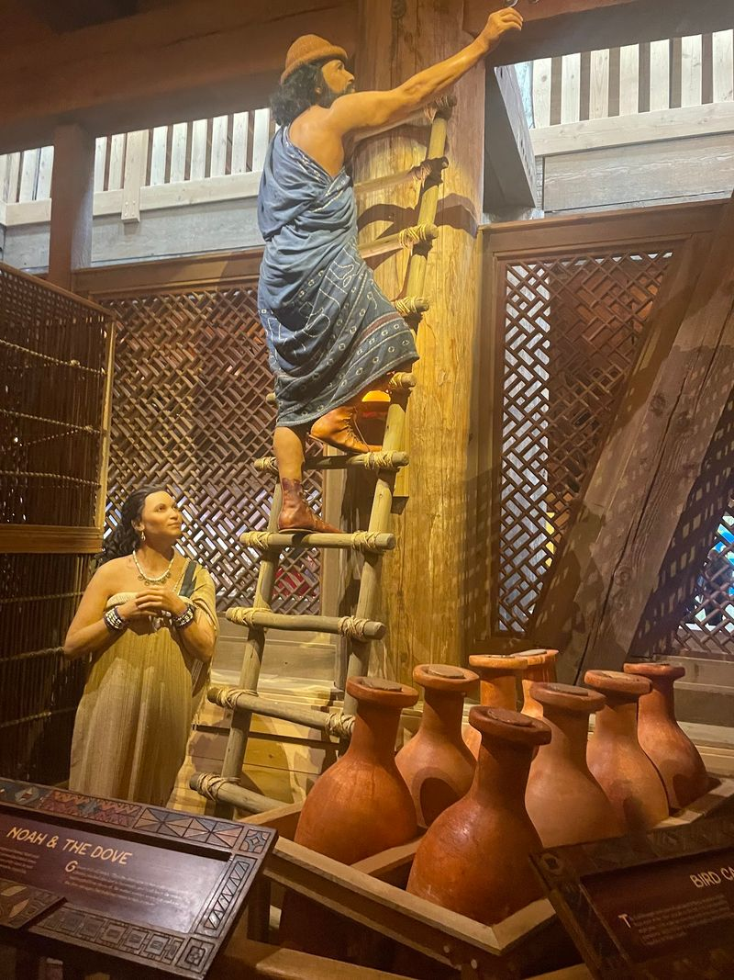
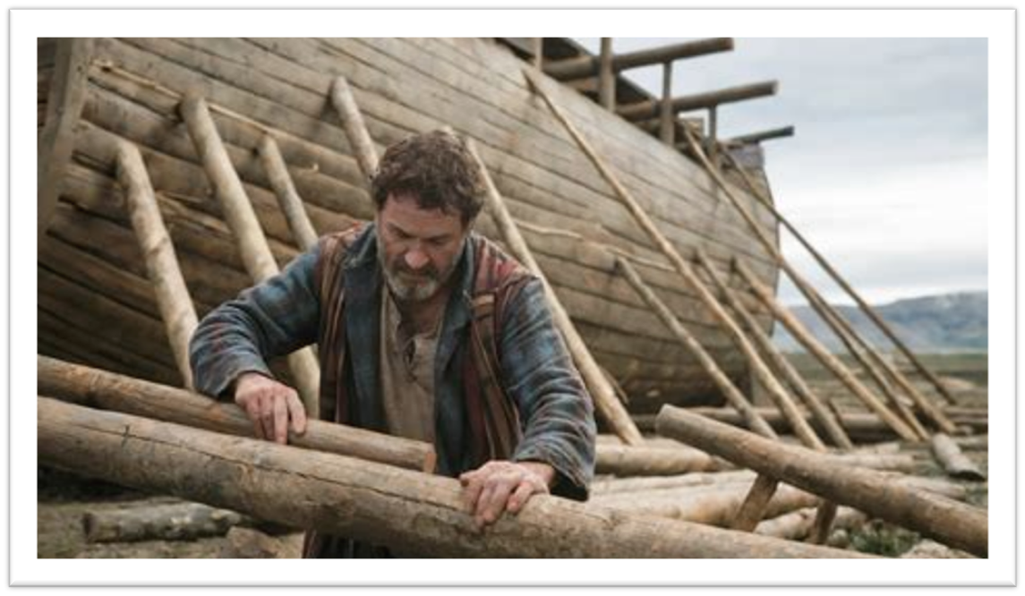

Slide 18
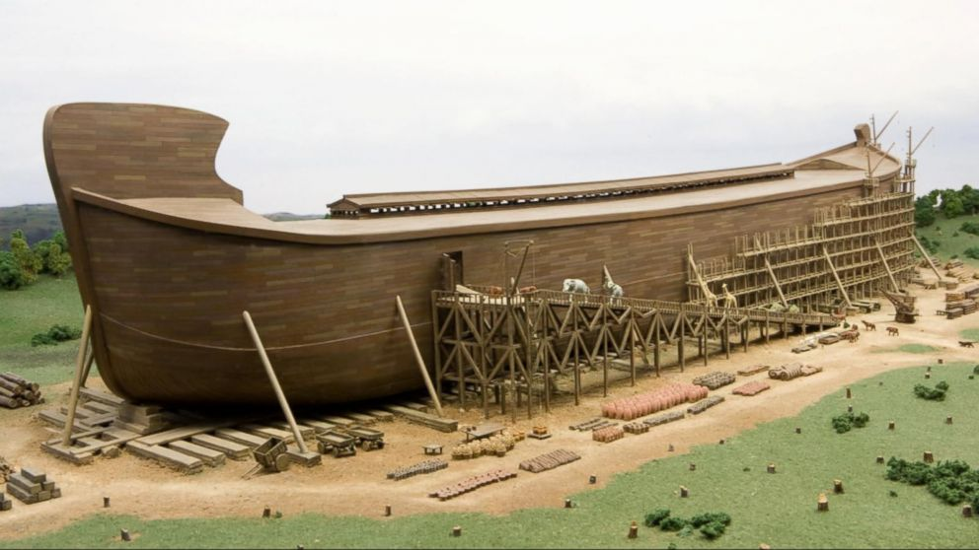

Slide 19
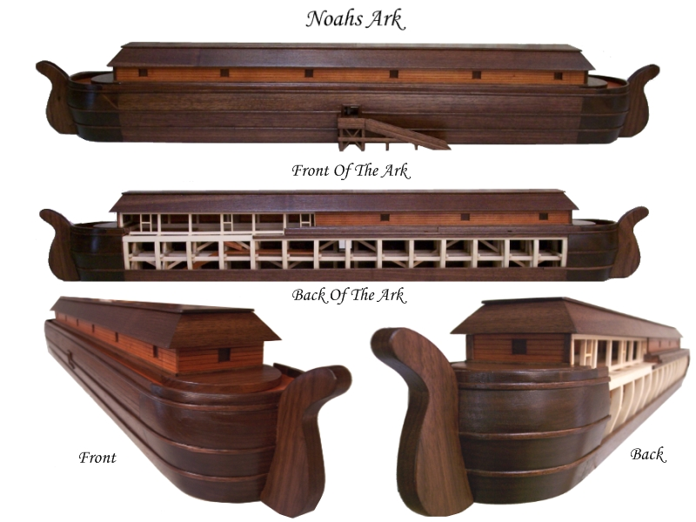

Slide 20
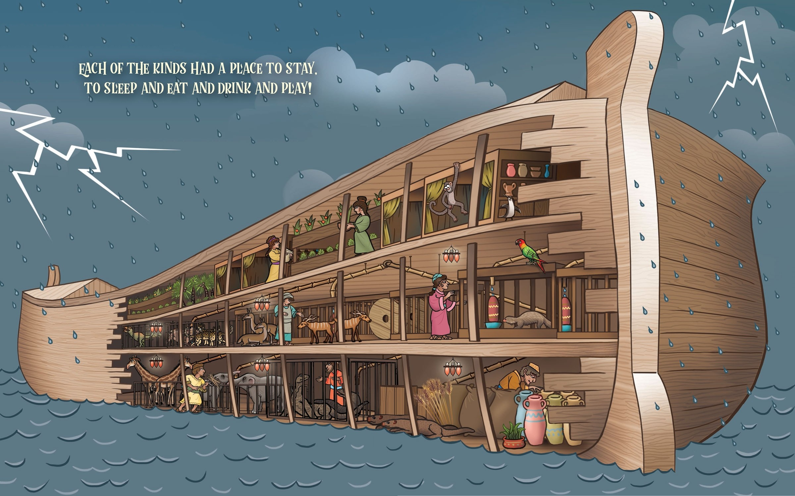

Slide 21
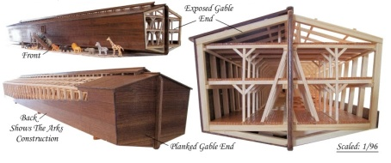

Slide 22
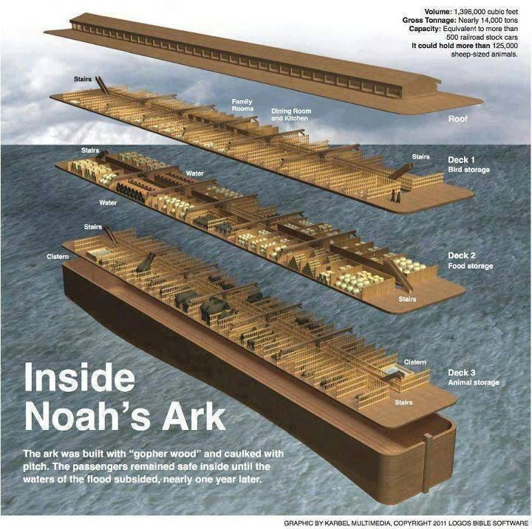

Slide 23
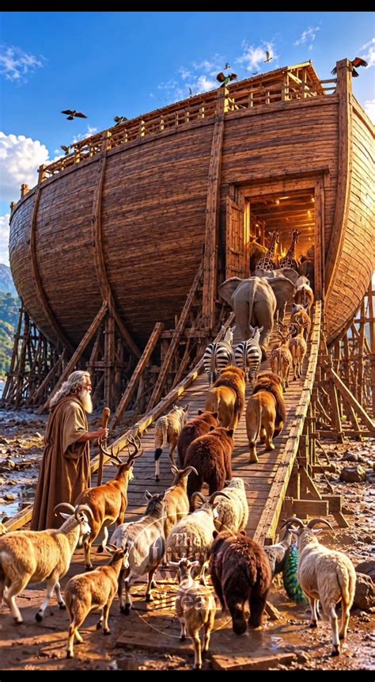

Slide 24
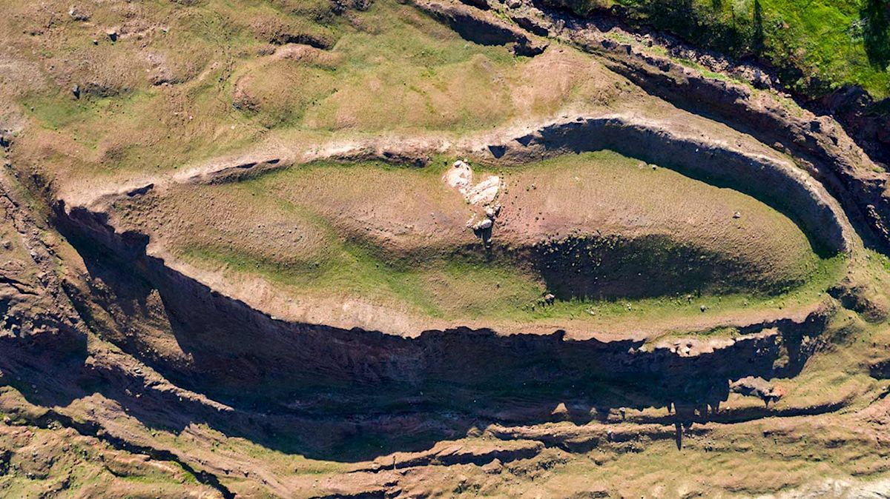

Slide 25
And I am sure of this, that he who began a good work in you will bring it to completion at the day of Jesus Christ. Philippians 1:6 ESV
for it is God who works in you, both to will and to work for his good pleasure. Philippians 2:13 ESV

Slide 26
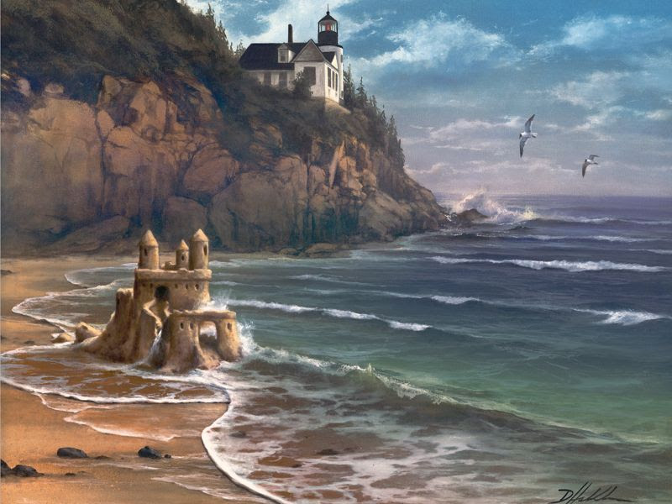

Slide 27
And going a little farther he fell on his face and prayed, saying, "My Father, if it be possible, let this cup pass from me; nevertheless, not as I will, but as you will."Matthew 26:39 ESV
looking to Jesus, the founder and perfecter of our faith, who for the joy that was set before him endured the cross, despising the shame, and is seated at the right hand of the throne of God. Hebrews 12:2 ESV

Slide 28
Trust in the LORD with all your heart And do not lean on your own understanding. In all your ways acknowledge Him, And He will make your paths straight. Proverbs 3:5-6
For we are His workmanship, created in Christ Jesus for good works, which God prepared beforehand so that we would walk in them. Ephesians 2:10

Slide 29
end of all flesh
all flesh in which is the breath of life under heaven.
Everything that is on the earth
every living thing of all flesh,

Slide 30
every living thing
all the high mountains under the whole heaven
all flesh
all mankind
Everything on the dry land in whose nostrils was the breath of life
every living thing that was on the face of the ground

Slide 31
…we will not fear though the earth give way, though the mountains be moved into the heart of the sea,
Psalm 46:2 ESV
God is our refuge and strength, a very present
(ever-present) help in trouble.
Psalm 46:1 ESV
My sheep hear my voice, and I know them, and they follow me. I give them eternal life, and they will never perish, and no one will snatch them out of my hand. John 10:27-28

Slide 32
But do not overlook this one fact, beloved, that with the Lord one day is as a thousand years, and a thousand years as one day. The Lord is not slow to fulfill his promise as some count slowness, but is patient toward you, not wishing that any should perish, but that all
should reach repentance.
2 Peter 3:8-9 ESV

Slide 33
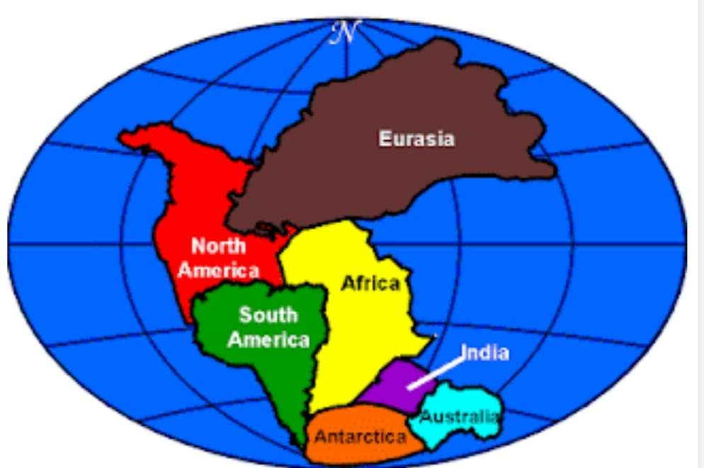
PANGEA

Slide 34
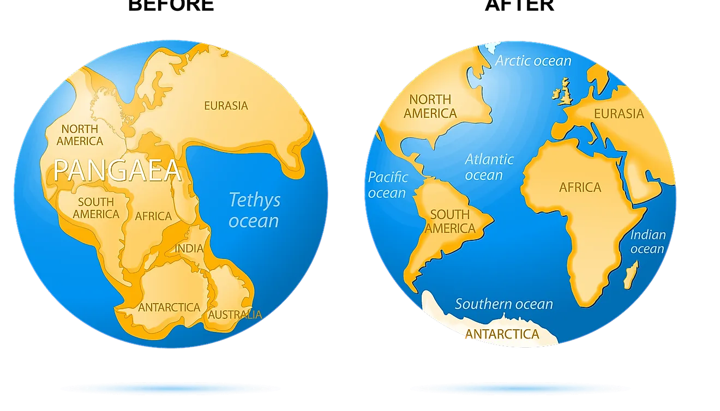

Slide 35
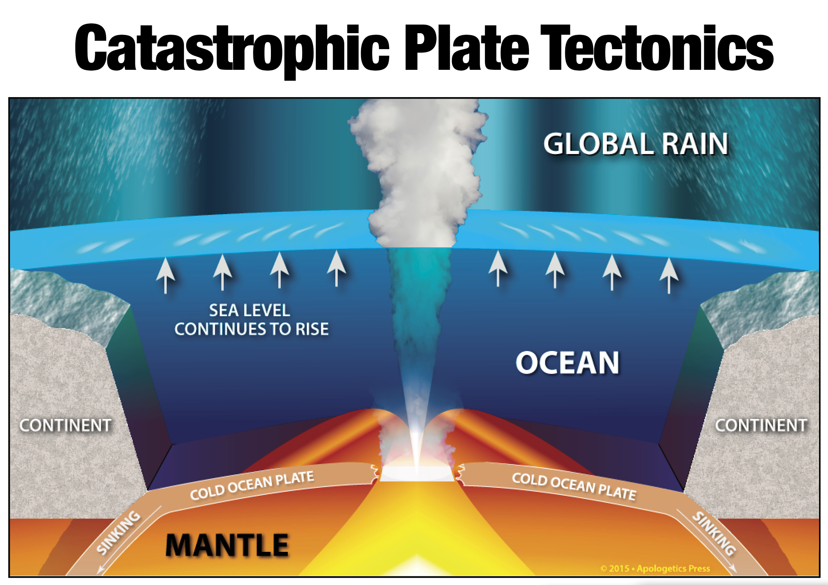

Slide 36
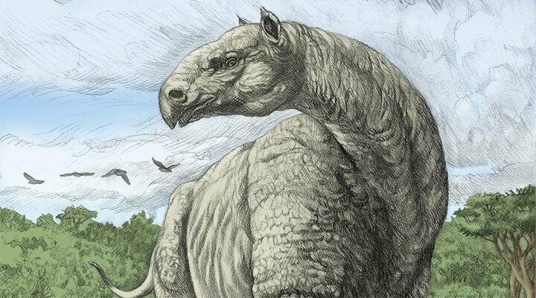
…His bones are tubes of bronze, his limbs like bars of iron. – Job 40:18 ESV

Slide 37
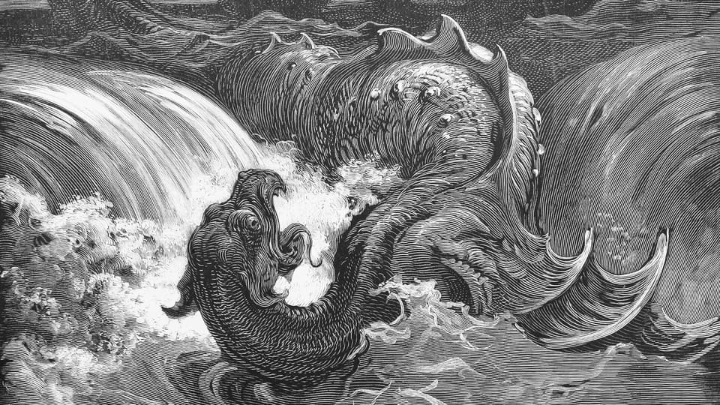
Can you draw out Leviathan with a fishhook or press down his tongue with a cord? –Job 41:1 ESV

Slide 38
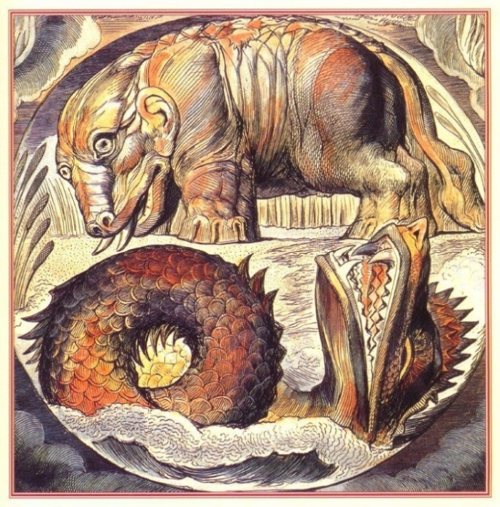

Slide 39
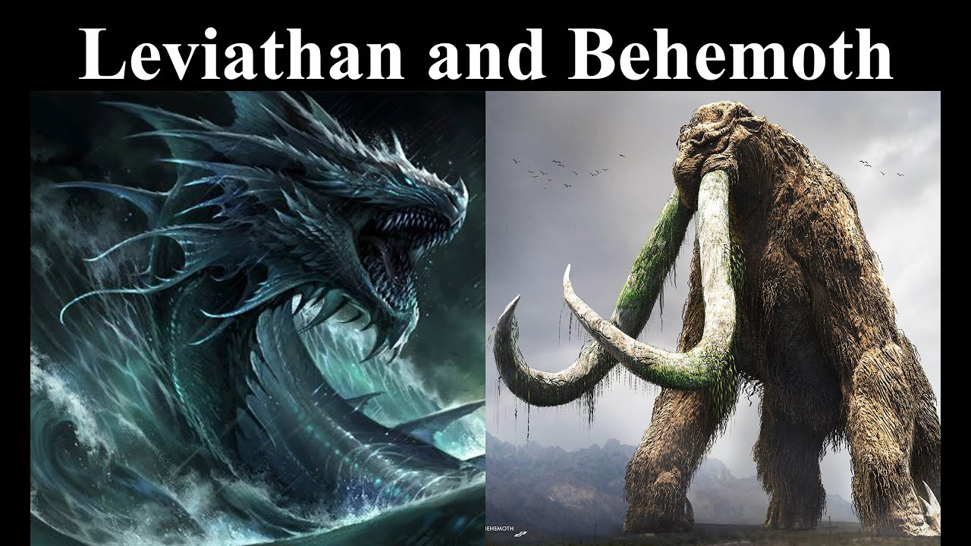

Slide 40
