Slide 1


Slide 2
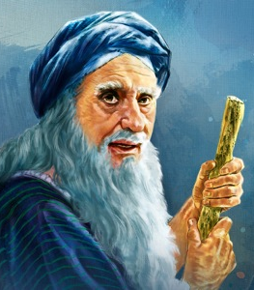
Joshua
Lesson 8
March 13, 2025
Largoseminolewomansbiblestudy.com
Notes:
NOTE: Check to make sure everyone who wishes has a set of notes. Explain the packet.

Slide 3
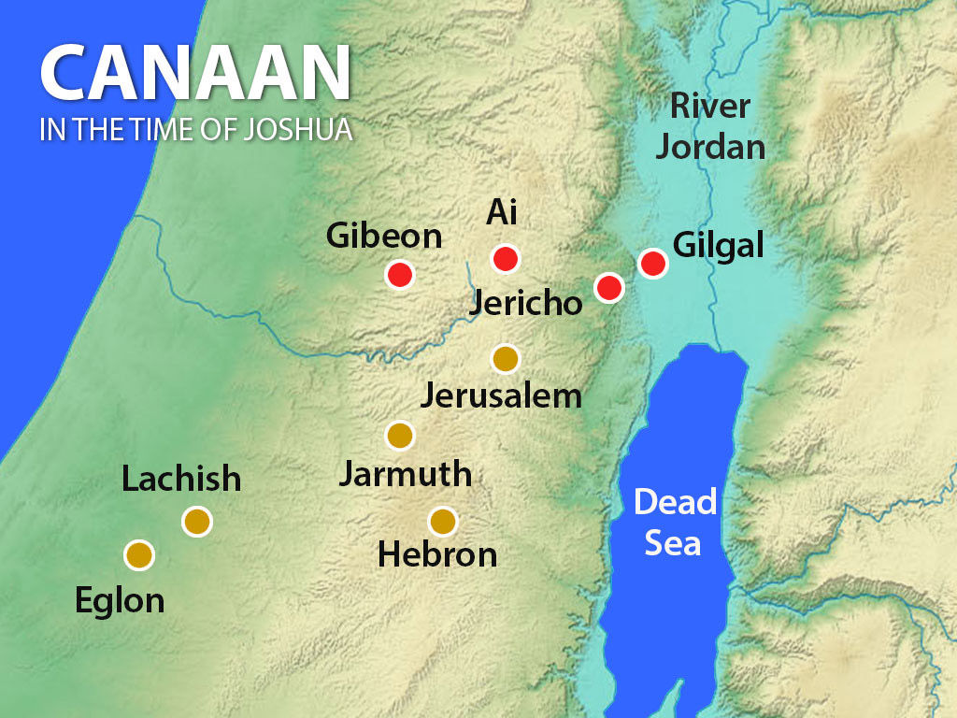

Slide 4
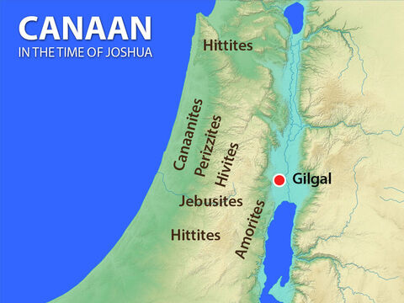
People Groups Living in the Promised Land

Slide 5
Gibeon’s strategy:
“If you can’t beat ‘em; Join ‘em!”

Slide 6
Joshua 10:1-2
“…when Adoni-zedek king of Jerusalem heard that Joshua had captured Ai…he feared greatly, because Gibeon was a great city, like one of the royal cities, and because it was greater than Ai, and all its men were mighty.”

Slide 7
5 miles NW of Jerusalem
Was a Hivite city
Later came under the control of the tribe of Benjamin (Josh 18:21-25)
Became a Levitical city (Josh 21:17)
King Saul was born in Gibeon (I Chr 9:35-39).

Slide 8
Gibeonites repeat:
v.6 “we have come from a far country”
v.9 “come from a very far country”
v. 13 “the very long journey”
v.6 “make a covenant with us”
v.8 “we are your servants”
v.9 “your servants have come”
v.11 “we are your servants…make a covenant”

Slide 9
Deut 20:10-15 “When you approach a city to fight against it, you shall offer it terms of peace. If it agrees to make peace with you and opens to you, then all the people who are found in it shall become your forced labor and shall serve you….Thus you shall do to all the cities that are very far from you, which are not of the cities of these nations nearby.”

Slide 10
The real problem:
Joshua 9:14
“So the men of Israel took some of their provisions, and did not ask for the counsel of the LORD.”

Slide 11
The necessity of trusting God for guidance:
Incident | Consult the Lord? | Outcome
Crossing the Jordan | Yes | Success and Safety
Capturing Jericho | Yes | Jericho destroyed
First Attack on Ai | No | Failure, 36 men killed
Second Attack on Ai | Yes | Ai destroyed
Gibeonites | No | Tricked into a covenant with Gibeon

Slide 12
Joshua’s dilemma:
God’s direction was to kill them:
Deuteronomy 7:1-5 "When the LORD your God brings you into the land which you go to possess, and has cast out many nations before you….you shall conquer them [and] utterly destroy them. You shall make no covenant with them nor show mercy to them…. ”

Slide 13
Joshua’s dilemma:
But the Law says to keep your word:
Deuteronomy 23:21-23 "If you make a vow to the LORD your God, you shall not delay fulfilling it, for the LORD your God will surely require it of you, and you will be guilty of sin….You shall be careful to do what has passed your lips….”

Slide 14
Psalm 15:1-4
“O LORD, who may abide in Your tent? Who may dwell on Your holy hill? He who walks with integrity, and works righteousness, and speaks truth in his heart. He does not slander with his tongue, nor does evil to his neighbor, nor takes up a reproach against his friend; he swears to his own hurt and does not change.”

Slide 15
Matthew 5:33-37 “…'You shall not swear falsely, but shall perform to the Lord what you have sworn.' But I say to you, Do not take an oath at all, either by heaven…or by the earth…or by Jerusalem…. And do not take an oath by your head…. Let what you say be simply 'Yes' or 'No'; anything more than this comes from evil.”

Slide 16
Future problems due to the vow with Gibeon:
Joshua 10:1-14 Israel will be forced into a premature battle with 5 cities
2 Samuel 21 Saul breaks the vow with the Gibeonites, and the Israelites suffer famine.

Slide 17
Joshua 9:19-20 “…We have sworn to them by the LORD, the God of Israel, and now we cannot touch them. This we will do to them, even let them live, so that wrath will not be upon us….”

Slide 18
Joshua 9:21 The solution to his dilemma:
“So they became hewers of wood and drawers of water for the whole congregation”
Josh. 9:23 “you shall never cease being slaves, both hewers of wood and drawers of water for the house of my God.”
Deut. 20:10-15 “…all the people who are found in it shall become your forced labor and shall serve you….”

Slide 19
Prophecies in Genesis 9-10:
Canaan: Gen 9:25 “Cursed be Canaan; A servant of servants He shall be to his brothers.”
Shem: Gen 9:26 “Blessed be the LORD the God of Shem, and let Canaan be his servant.”
Gen 10:15 “Canaan became the father of…the Jebusite and the Amorite and the Girgashite and the Hivite and the Arkite and the Sinite and the Arvadite and the Zemarite and the Hamathite…” Gibeonites were Hivites.

Slide 20
Warren Wiersbe:
“Looking down the centuries, Noah predicted three times that the descendants of Canaan would become the lowest of servants. The Canaanites are listed in Genesis 10:15-19 and are the very nations the Israelites conquered and whose land they inhabited.”

Slide 21
Joshua 9:27 “But Joshua made them that day cutters of wood and drawers of water for the congregation and for the altar of the LORD, to this day, in the place that he should choose….”

Slide 22
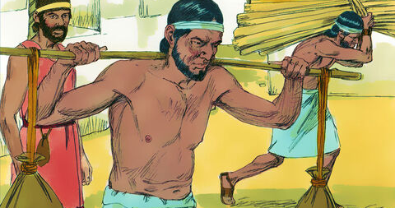

Slide 23
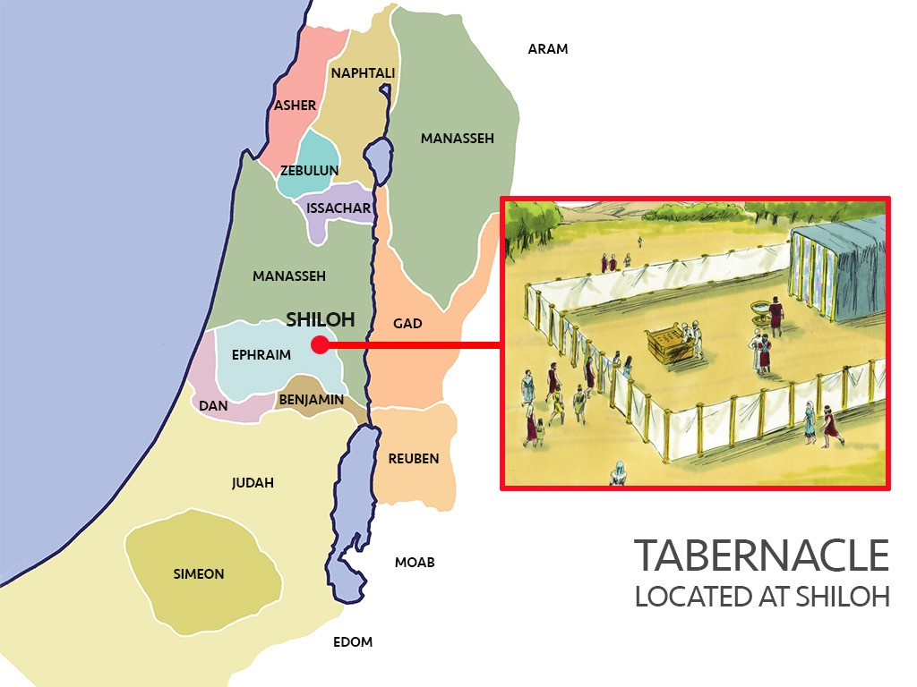

Slide 24
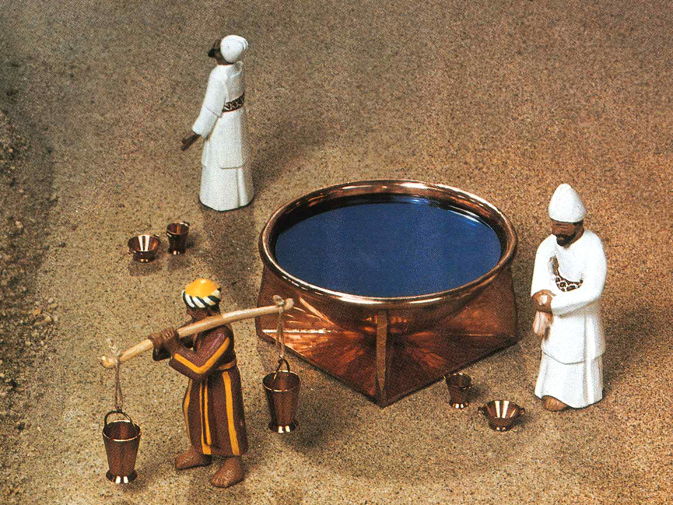
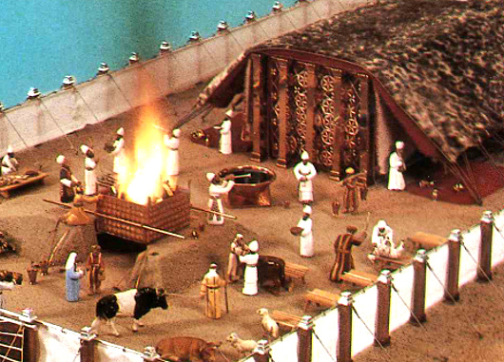
The Gibeonites bring water and wood for the tabernacle

Slide 25
Joshua 9:27 “But Joshua made them that day cutters of wood and drawers of water for the congregation and for the altar of the LORD, to this day, in the place that He should choose.”

Slide 26
Deut. 12:5-7 “But you shall seek the LORD at the place which the LORD your God will choose from all your tribes, to establish His name there for His dwelling, and there you shall come. There you shall bring your burnt offering, your sacrifices, your tithes, the contributions of your hand, your votive offerings, and the firstborn of your herd and of your flock…. you and your households shall…rejoice in all your undertakings in which the LORD your God has blessed you.”

Slide 27
Psalm 84:10
“For a day in Your courts is better than a thousand outside. I would rather stand at the threshold of the house of my God than dwell in the tents of wickedness.”

Slide 28
Blessings for Gibeon:
Gibeon becomes a priestly city; the ark of the covenant often stayed there. 1 Chr. 16:39-40; 21:29
One of David’s mighty men was a Gibeonite. 1 Chr. 12:4
God appeared & spoke to Solomon at Gibeon, where Solomon asked for wisdom. 1 Kings 3:4-5
Gibeonites were among those who returned with Ezra to restore the temple and rebuild the walls of Jerusalem after the exile. Ezra 2:43; Neh.3:7;7:25

Slide 29
Lessons from Joshua 9:
Use discernment, and don’t be pressured to make a quick decision.
Pray about EVERYTHING! Josh 9:14 The men of Israel “did not ask for the counsel of the LORD.”
When you make a vow, keep it, even if it’s inconvenient. To not honor your vow brings dishonor on the Lord you serve. (Josh 9:19)
God can redeem even our failures. The Gibeonites were brought into the household of Israel because Joshua let them live. Josh 9:27

Slide 30
The Lord’s desire is redemption:
2 Peter 3:9 “The Lord is not slow to fulfill his promise as some count slowness, but is patient toward you, not wishing that any should perish, but that all should reach repentance.”

