Slide 1
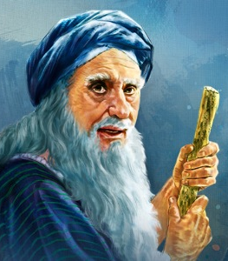
I Samuel
Chapters 16-17
Largoseminolewomansbiblestudy.com
Notes:
NOTE: Check to make sure everyone who wishes has a set of notes. Explain the packet.

Slide 2


Slide 3
I Samuel
Chapters 16-17
Largoseminolewomansbiblestudy.com
Notes:
NOTE: Check to make sure everyone who wishes has a set of notes. Explain the packet.

Slide 4


Slide 5
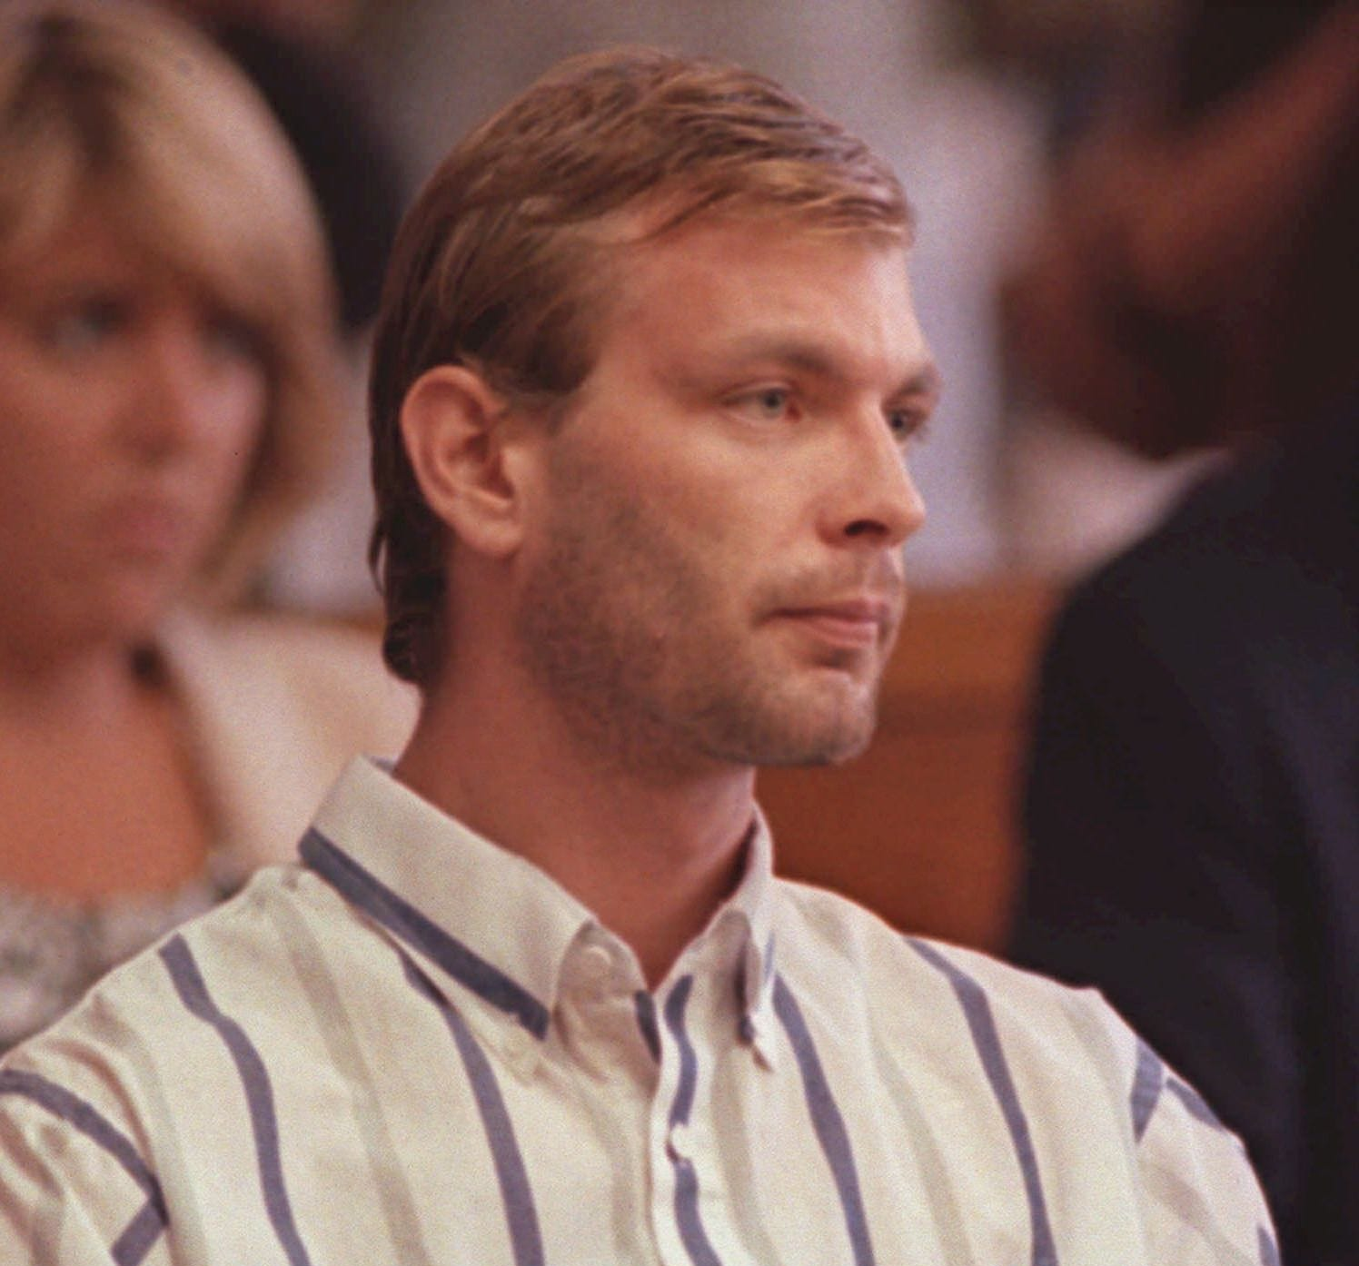
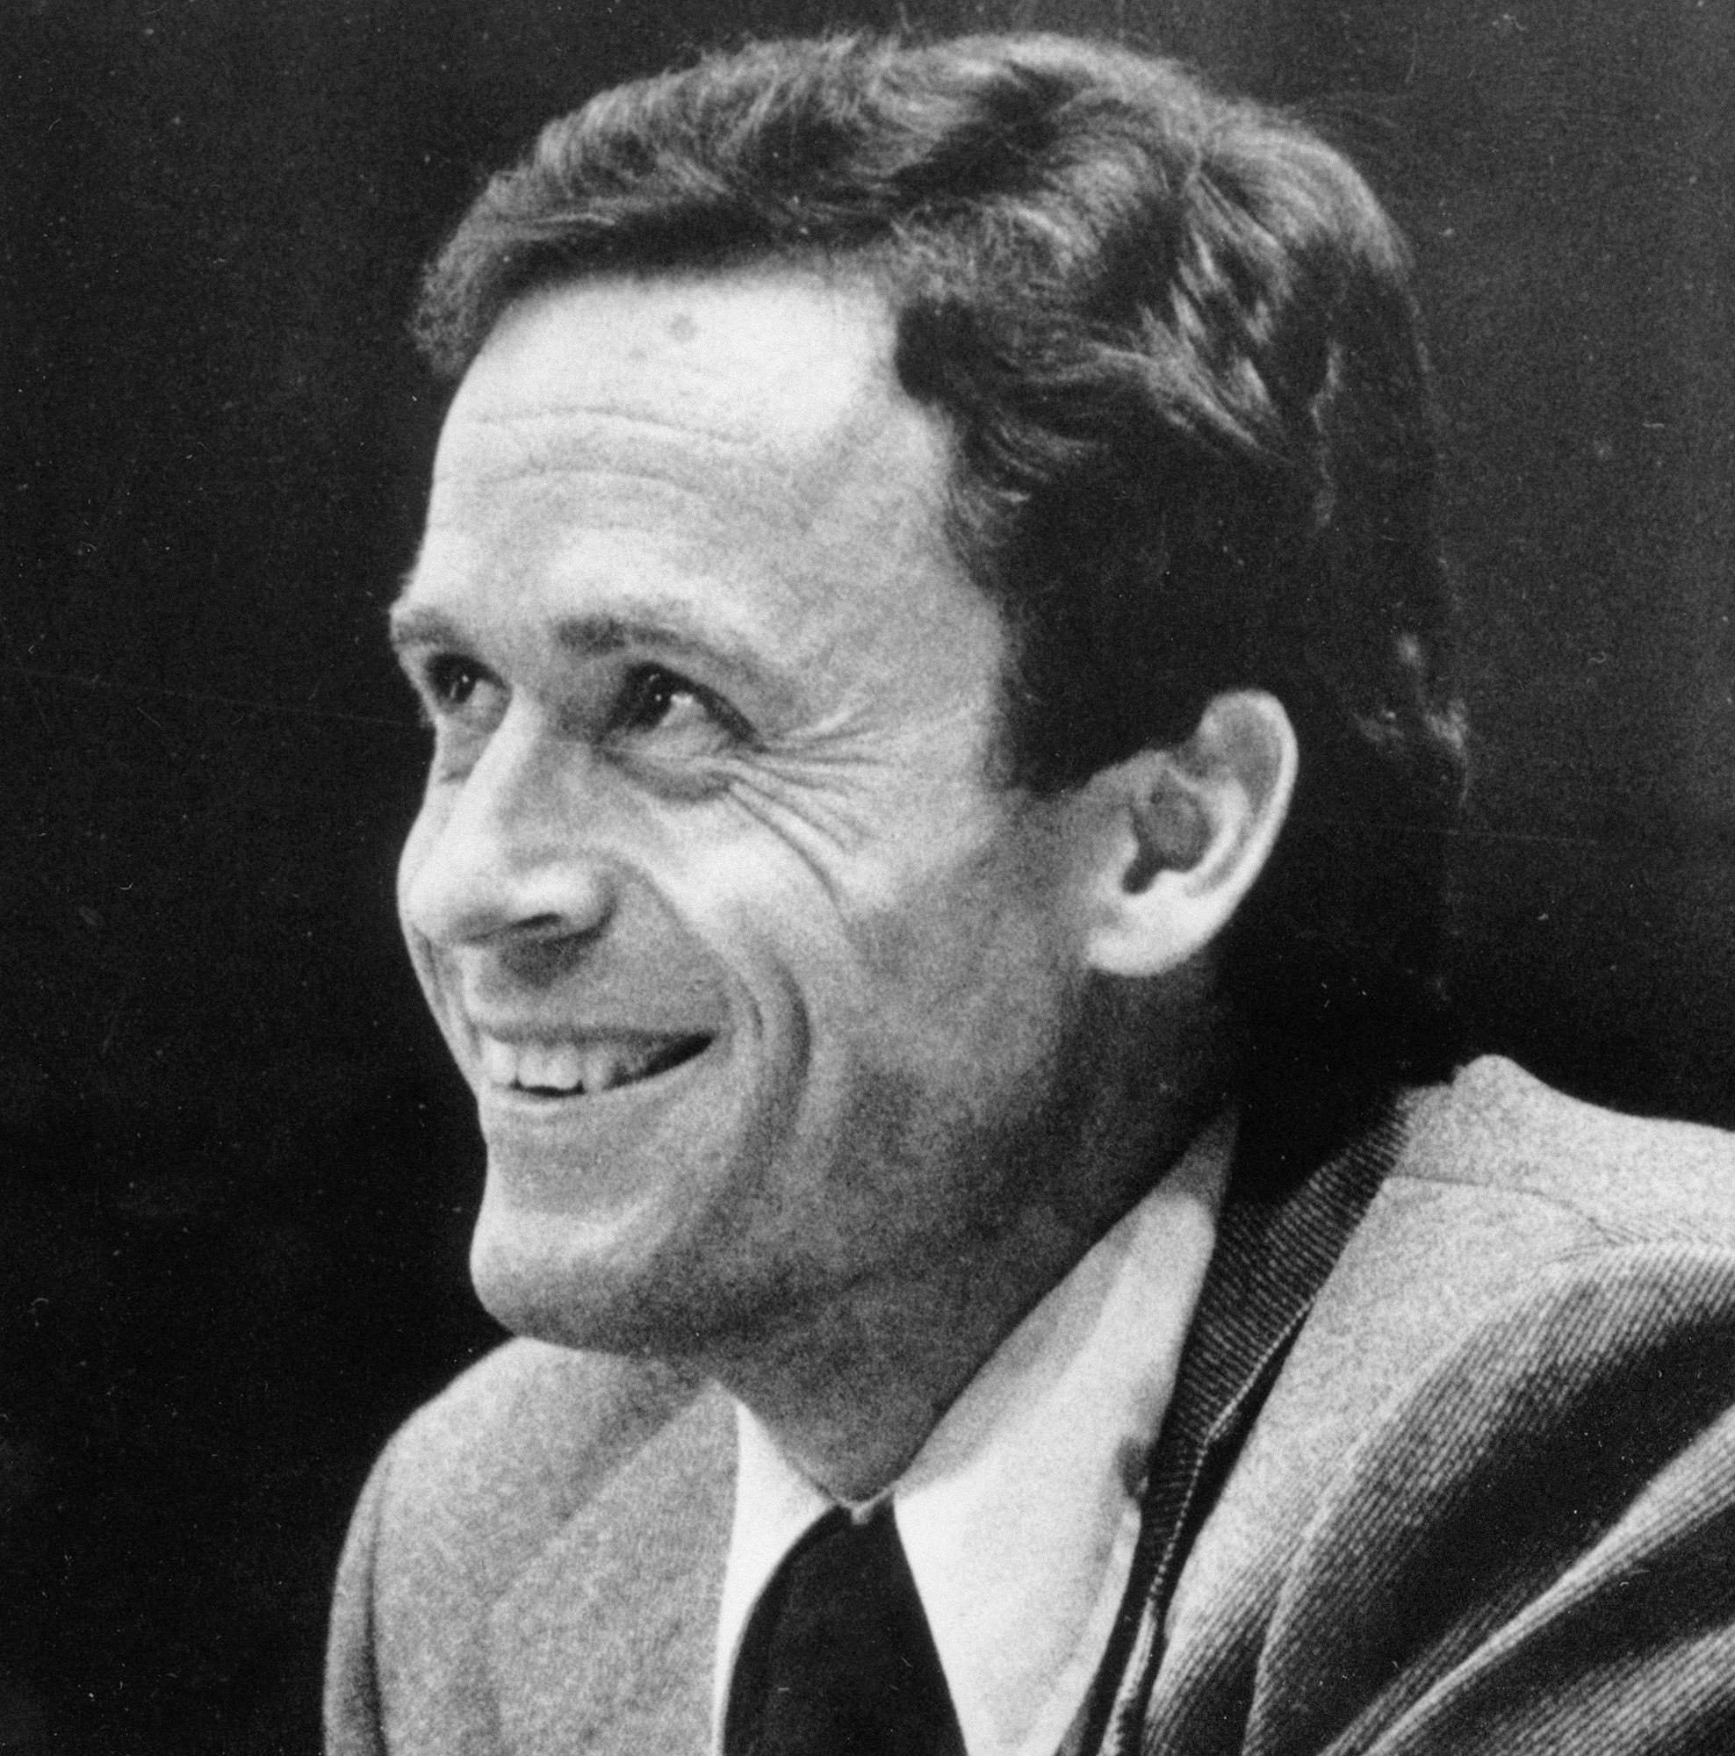

Slide 7
Do you think God sent you into the world only to stitch at that machine, or to go up a ladder with bricks, or to sweep that gutter? He sent you into the world to be made a beautiful being, with a holy character, a sweet disposition, an angelic life. Let us live for our high destiny. Do not be troubled though it takes many years to grow beautiful.

Slide 8
Can the Holy Spirit leave a true Christian?
We have eternal life. (John 3:16)
We are children born of God. (John 1:12-13 )
We are adopted. (Romans 8:15)
We are sealed. (Ephesians 1:13)
We have a guarantee (2 Corinthians 1:22)

Slide 9
…an evil spirit from God???
1. Sometimes "evil" indicates disaster or tragedy.
… Shall we receive good from God, and shall we not receive evil?... (Job 2:10 ESV)

Slide 10
…an evil spirit from God???
2. We must control our thought life.
Great peace have those who love Your law, And nothing causes them to stumble. (Psalm 119:165 NKJV)
The law of the LORD is perfect, reviving the soul; the testimony of the LORD is sure, making wise the simple; (Psalm 19:7 ESV)

Slide 11
…an evil spirit from God?
3. God is in charge of all things, including evil spirits, and may use them for His purposes.
To cause the downfall of His enemies: 1 Kings 22:19-23
To demonstrate the faith of the believer: Job
To develop character in the believer: (2 Corinthians 12:7), (1 Timothy 1:19-20)

Slide 13
Lessons from David and Goliath: Battling The Giant
1. David sees that this battle is not between Goliath and David, but between Goliath and God.
2. David sees Goliath from God's perspective.
3. He declares the superiority of his God.

Slide 14
LSWBS RADIO THEATER
presents
GOLIATH and the ISRAELITES
FEATURING THERESA AS GOLIATH, PAT AS DAVID, AND MARGUERITE AS THE PHILISTINE COMMANDER

Slide 15
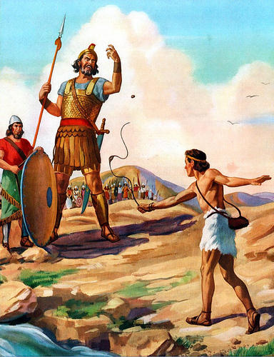

Slide 16
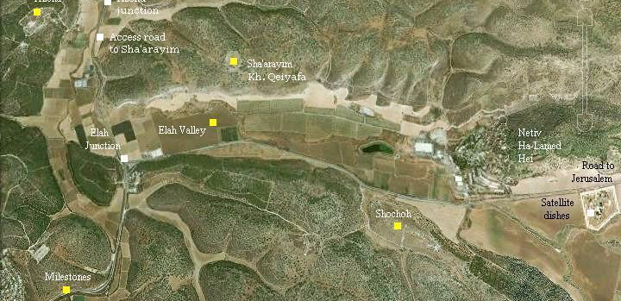
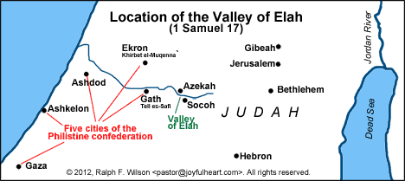

Slide 18
David is anointed 1 Samuel 16:13
Saul is troubled, David begins to "work for" Saul (still lives at home) 1 Samuel 16:18, 21-23
Saul doesn’t seem to recognize David when he fights Goliath 1 Samuel 17:56
David comes to live with Saul 1 Samuel 18:1-2
Saul makes David a military officer 1 Samuel 18:5

