Slide 1
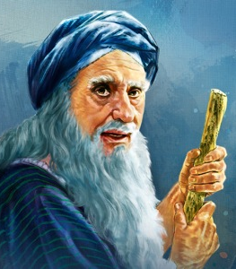
I Samuel
Chapter 6-7
Largoseminolewomansbiblestudy.com
Notes:
NOTE: Check to make sure everyone who wishes has a set of notes. Explain the packet.

Slide 2


Slide 3
I Samuel
Chapter 6-7
Largoseminolewomansbiblestudy.com
Notes:
NOTE: Check to make sure everyone who wishes has a set of notes. Explain the packet.

Slide 4
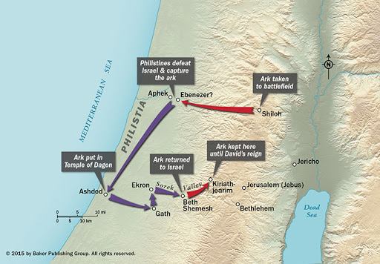

Slide 5
“But you shall seek the LORD at the place which the LORD your God will choose from all your tribes.…There you shall bring your burnt offerings, your sacrifices, your tithes…and the firstborn of your herd and of your flock.” Deut 12:5-6

Slide 6
“priests…the diviners” = the leaders of their cultic worship
Isaiah 2:6 “…Your people… are filled with influences from the east, and they are soothsayers like the Philistines….”

Slide 7
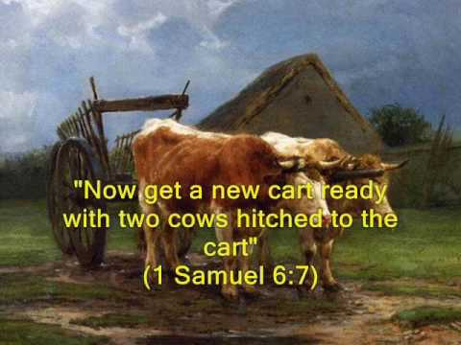

Slide 8
I Samuel 6:19 50,070 or 70??
NAS, KJV = 50,070
NIV, ESV = 70
Hebrew = “of the people seventy men, fifty thousand men”

Slide 9
“Who is able to stand before the LORD, this holy God?”
I Samuel 6:20

Slide 11
“…If you return to the LORD with all your heart, remove the foreign gods and the Ashtaroth from among you and direct your hearts to the LORD and serve Him alone; and He will deliver you from the hand of the Philistines.”
I Samuel 7:3

Slide 12
“…Pour out your heart like water before the presence of the LORD; lift up your hands to Him….” Lam. 2:19

Slide 13
Lessons from I Samuel 6 & 7:
Remembering is important! Stones of remembrance: 6:18, 7:12; Josh 4:1-7
Incomplete repentance is dangerous! II Cor 7:10

Slide 14
“For the sorrow that is according to the will of God produces a repentance without regret, leading to salvation; but the sorrow of the world produces death.”
II Cor 7:10

Slide 15
Lessons from I Samuel 6 & 7:
Remembering is important! Stones of remembrance: 6:18, 7:12; Josh 4:1-7
Incomplete repentance is dangerous! II Cor 7:10
God is Holy. 6:20; Rom 3:23; Rom 6:23

