Slide 1
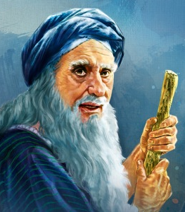
I Samuel
Lesson 5
Largoseminolewomansbiblestudy.com
Notes:
NOTE: Check to make sure everyone who wishes has a set of notes. Explain the packet.

Slide 2


Slide 3
I Samuel
Lesson 5
Largoseminolewomansbiblestudy.com
Notes:
NOTE: Check to make sure everyone who wishes has a set of notes. Explain the packet.

Slide 4
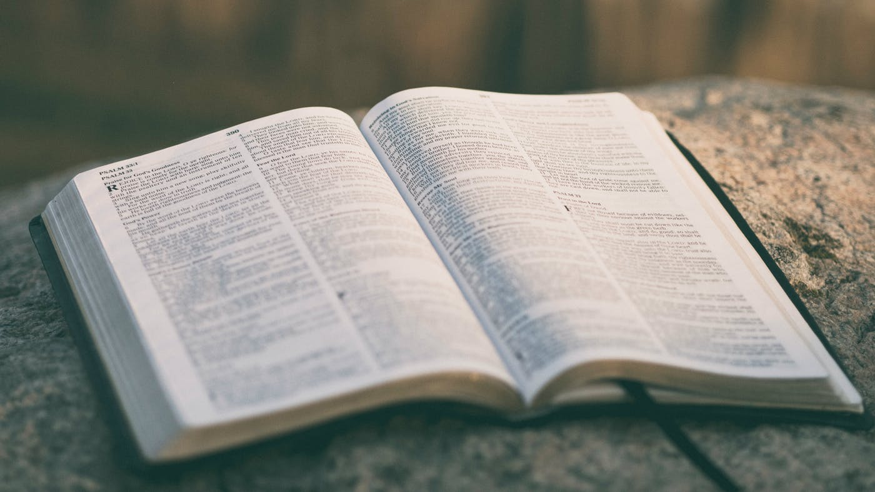
Train up a child in the way he should go: and when he is old, he will not depart from it. (Proverbs 22:6 KJV)
I hated all my toil …., seeing that I must leave it to the man who will come after me, and who knows whether he will be wise or a fool?... (Ecclesiastes 2:18-19 ESV)

Slide 6
"If the world hates you, know that it has hated me before it hated you. ... Remember the word that I said to you: 'A servant is not greater than his master.' If they persecuted me, they will also persecute you. If they kept my word, they will also keep yours. (John 15:18, 20 ESV)
If you are insulted for the name of Christ, you are blessed, because the Spirit of glory and of God rests upon you. (15) But let none of you suffer as a murderer or a thief or an evildoer or as a meddler. (troublemaker, busybody, overseer of other people's matters) (1 Peter 4:14-15 ESV)

Slide 7
…And behold, I am with you always, to the end of the age.”(Matthew 28:20 ESV)
I in them and you in me, that they may become perfectly one, so that the world may know that you sent me and loved them even as you loved me.
(John 17:23 ESV)

Slide 9
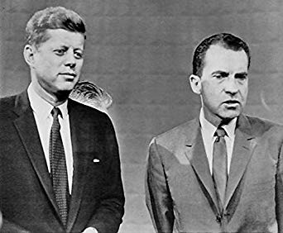
… man looks on the outward appearance, but the LORD looks on the heart."
(1 Samuel 16:7)
Who are you to pass judgment on the servant of another? It is before his own master that he stands or falls…
(Romans 14:4 ESV)

Slide 10
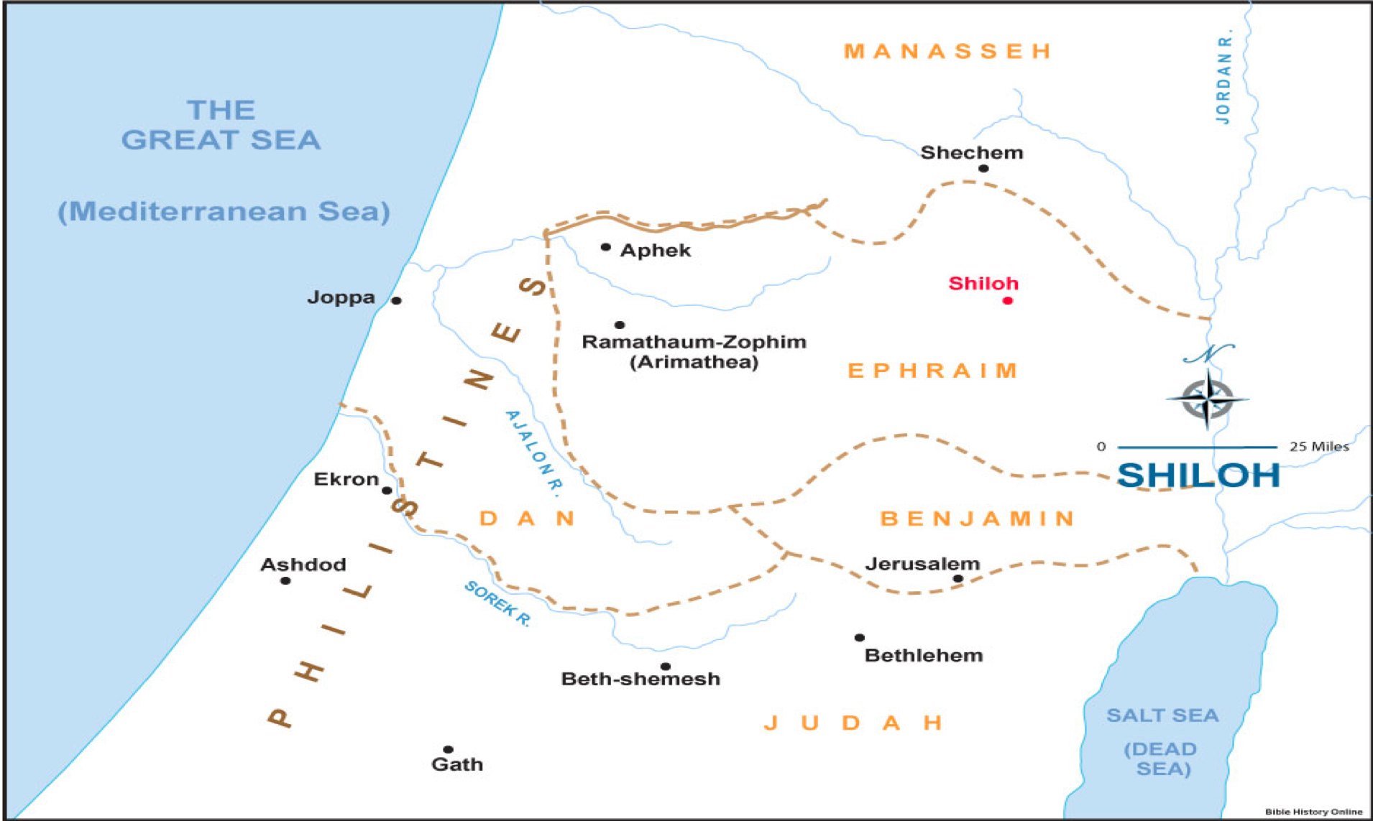

Slide 12
"What does it mean that God is sovereign?"
He is absolute in authority and unrestricted in His supremacy
In the beginning God created the heaven and the earth.
(Genesis 1:1)
The heavens declare the glory of God; and the firmament shows his handiwork.
(Psalm 19:1)

Slide 13
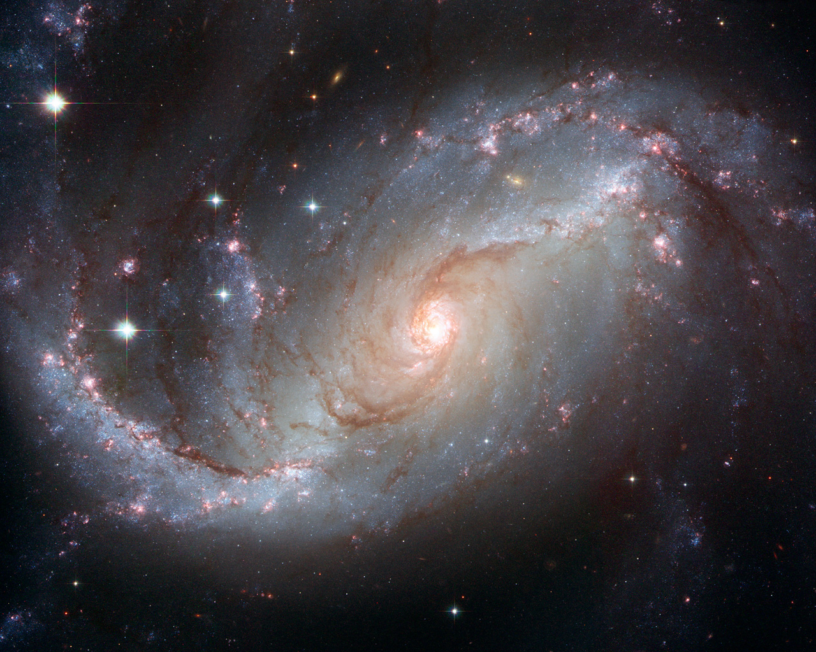

Slide 14
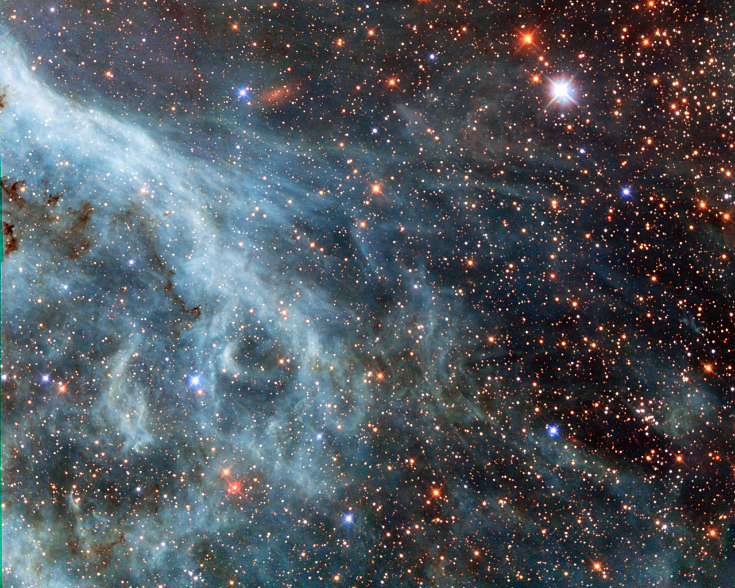

Slide 15
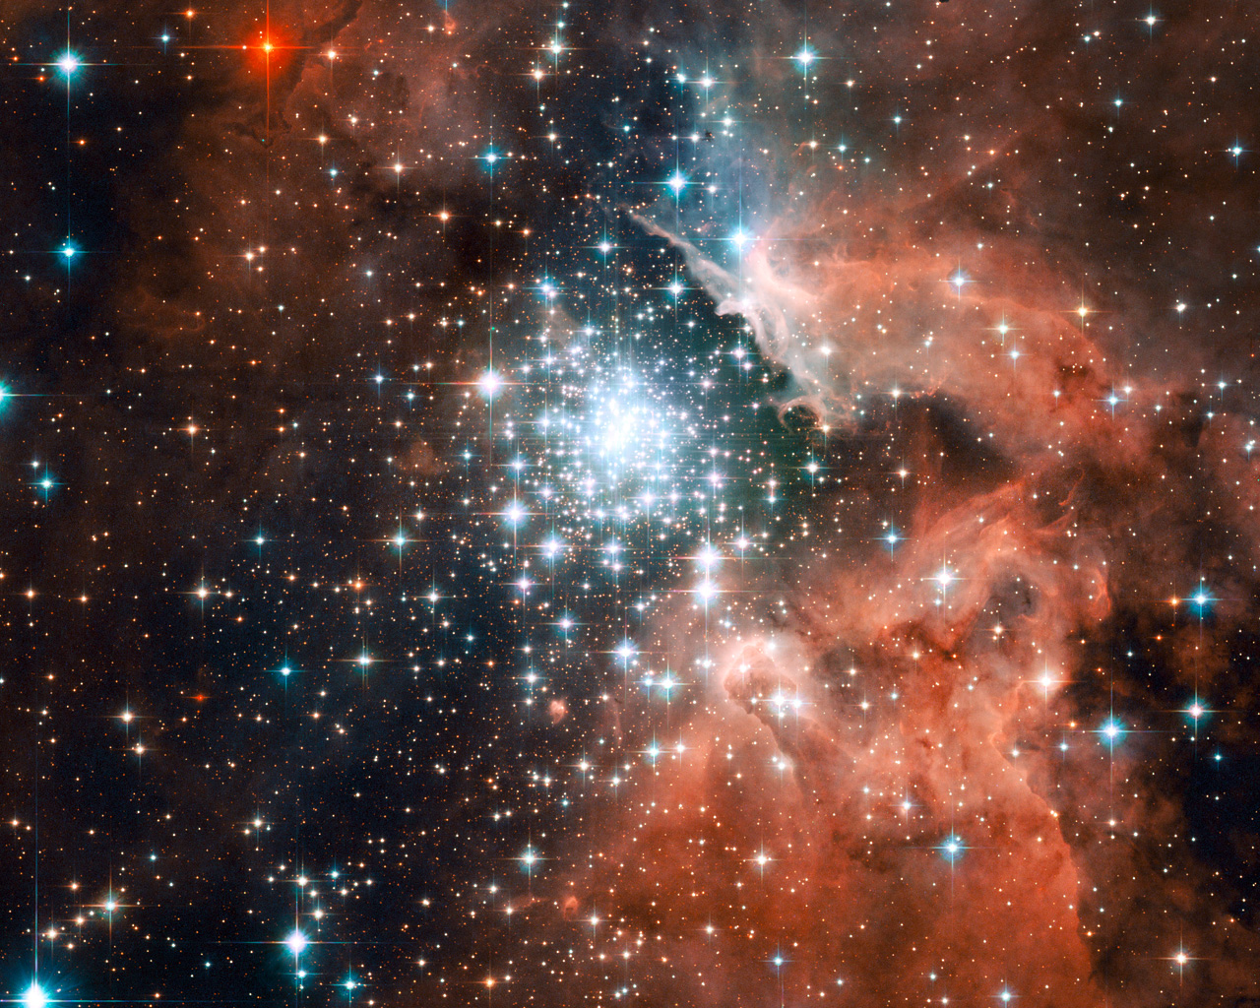

Slide 16
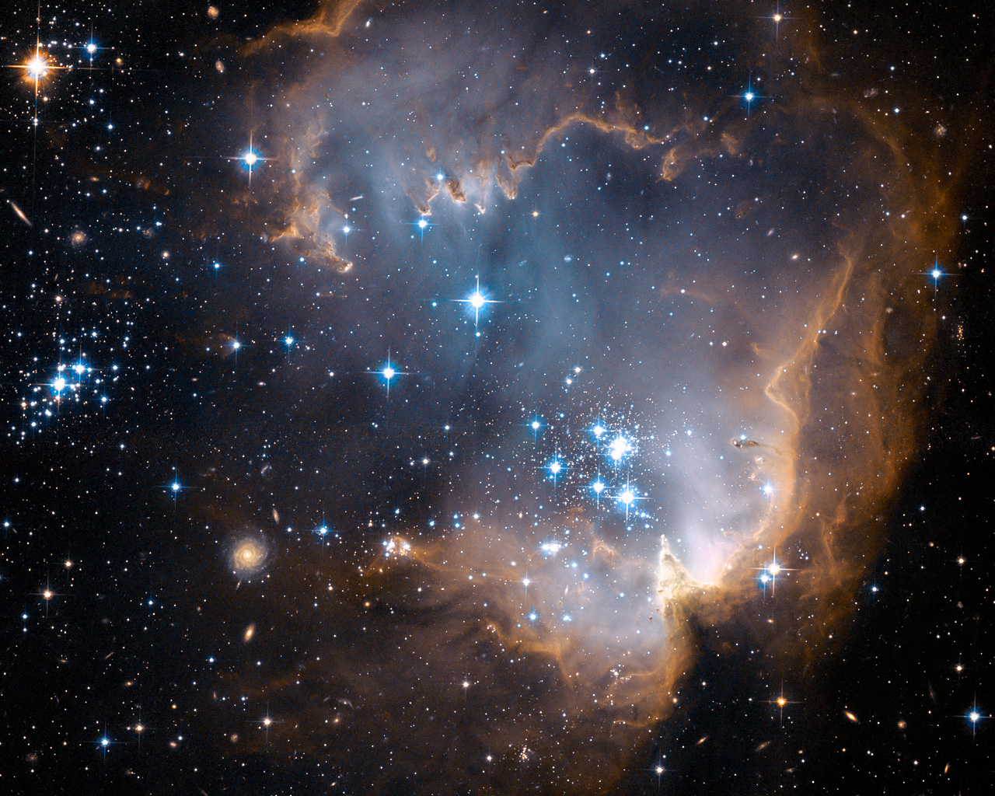

Slide 17
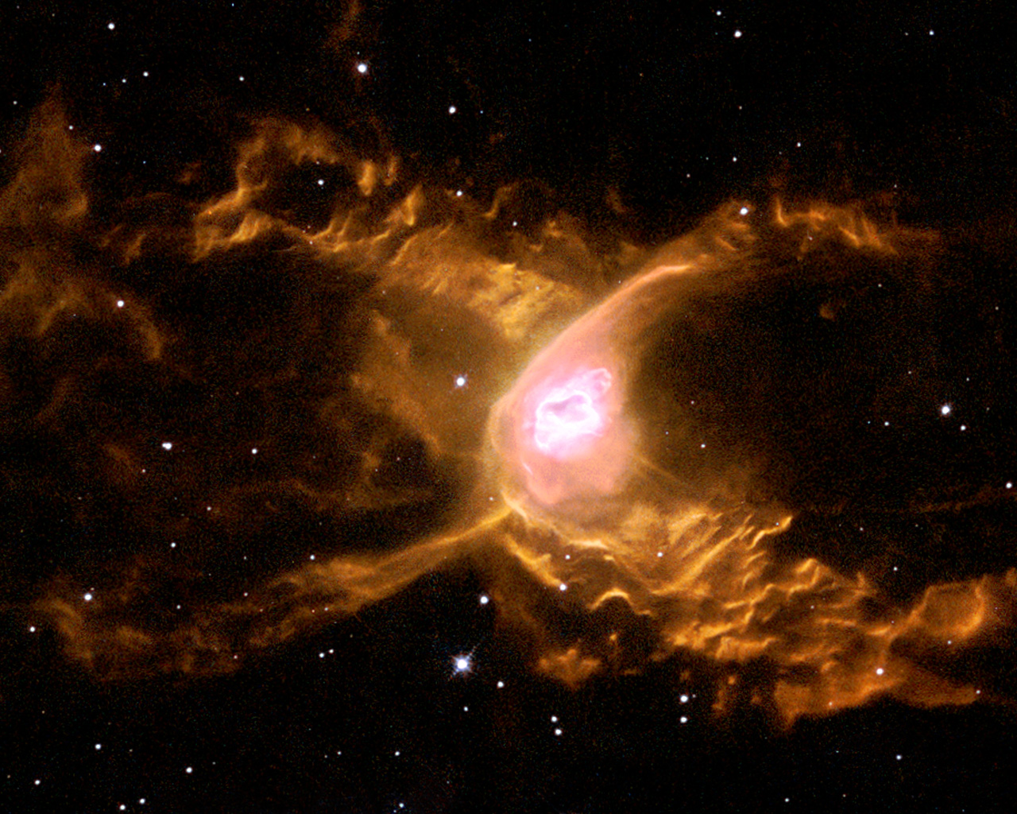

Slide 18
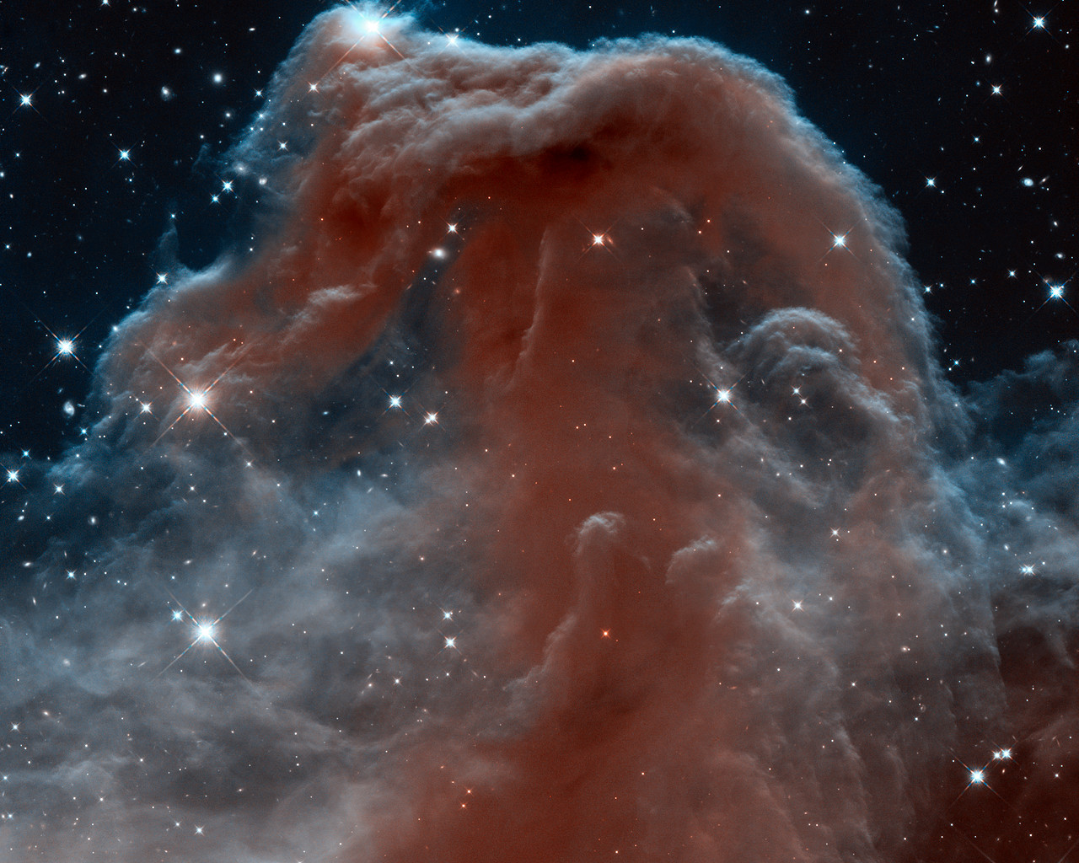

Slide 19
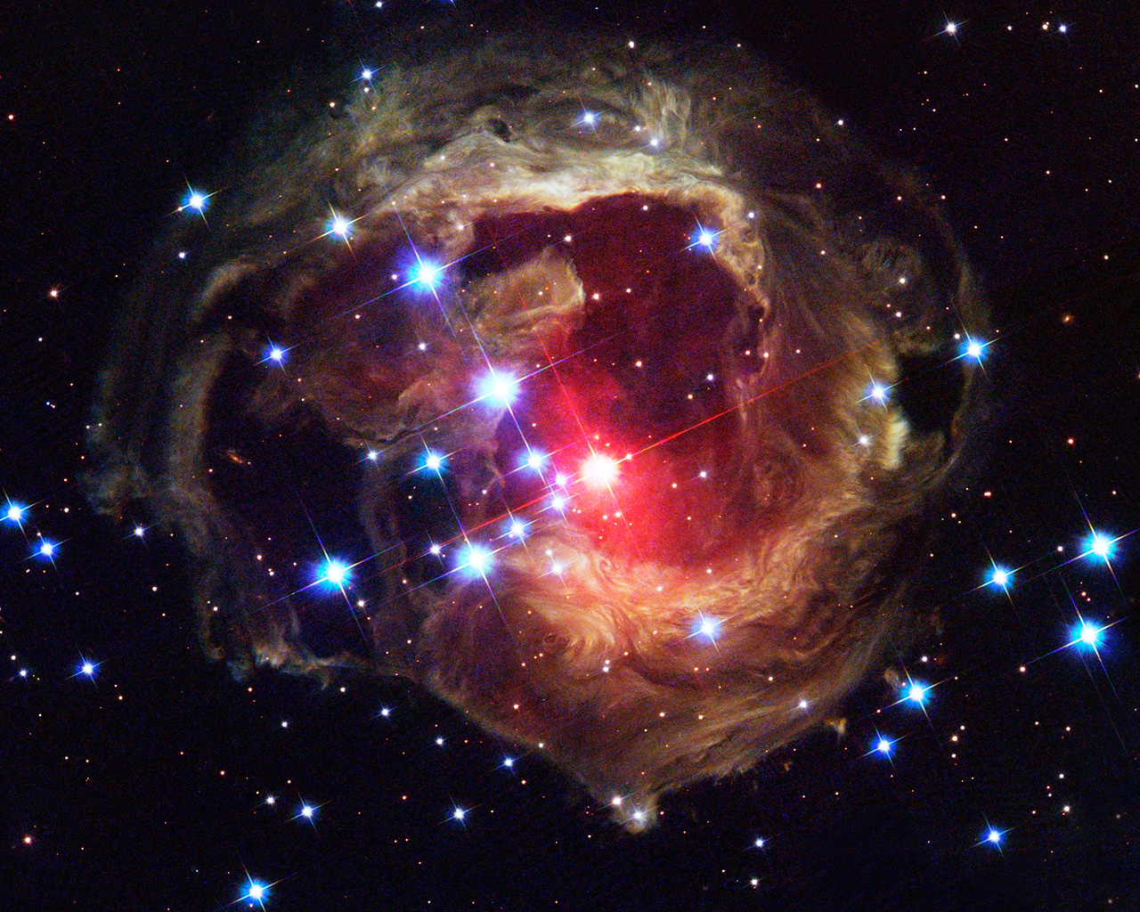

Slide 20
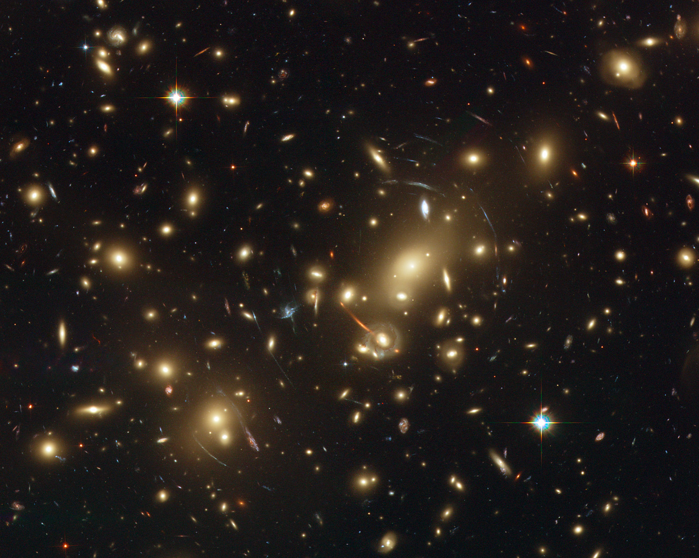

Slide 21
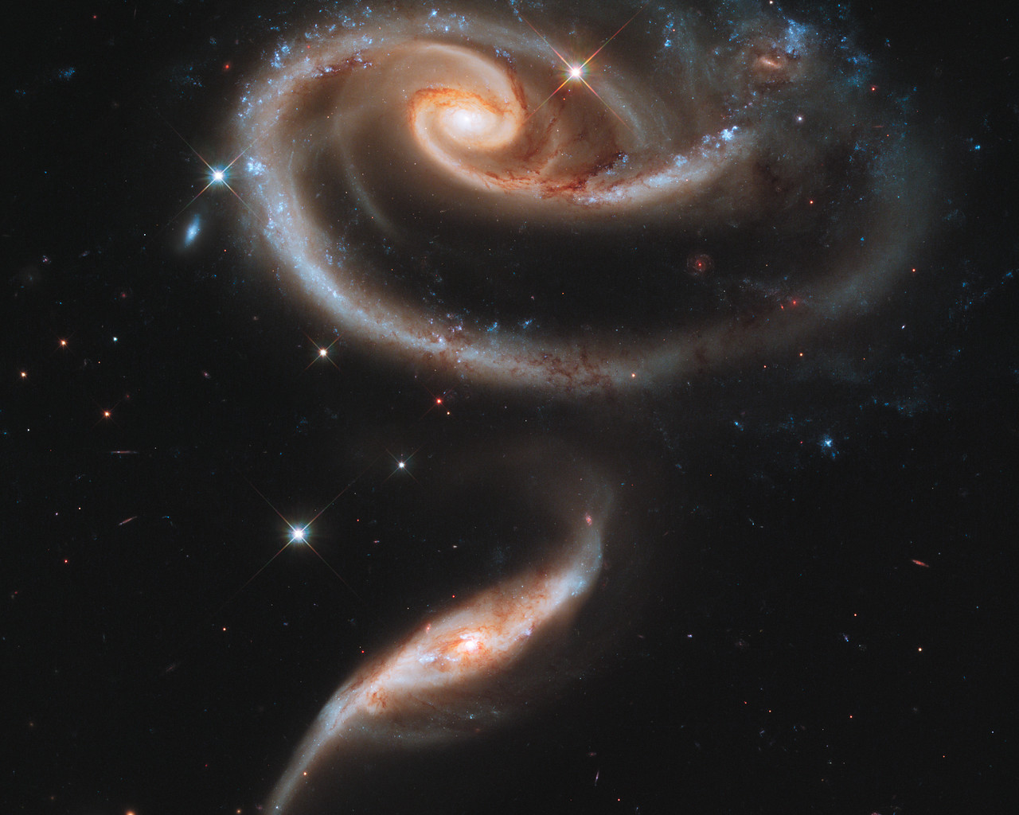
I am Alpha and Omega, the beginning and the end, the first and the last.
(Revelation 22:13 KJV)

